Slide 1
Data discovery project
Team-2
Akash Taploo | Raj Jasani | Sameer Bhattarai | Sneha Mondal

Slide 2
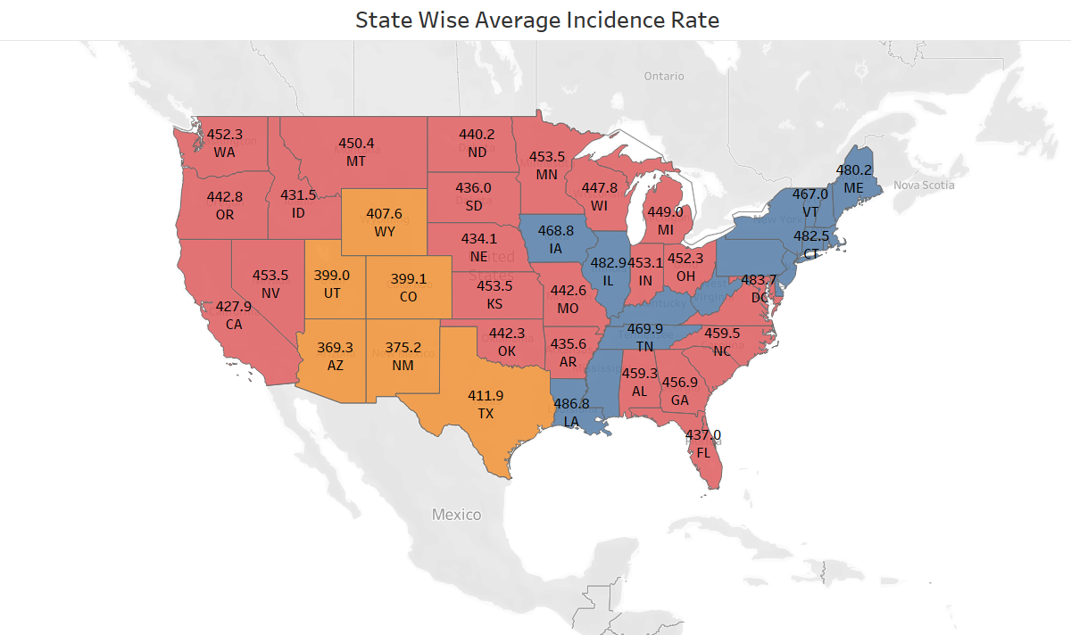

Question-1
Average Incidence Rate – state Wise
NY 497.5
In response to Rochester Regional Health's first query, our team, carried out examination on state-level data. By doing so, we were able to calculate the average incidence rate for each state within their respective regions. Our findings revealed that Kentucky, New York, and Delaware have the highest cancer incidence rates, while Arizona and New Mexico exhibit the lowest rates. This information could prove invaluable for our client as they seek to identify best practices or other contributing factors that have enabled Arizona and New Mexico to achieve greater success in combating cancer.`
DE 498.2
KY 517.3

Slide 3
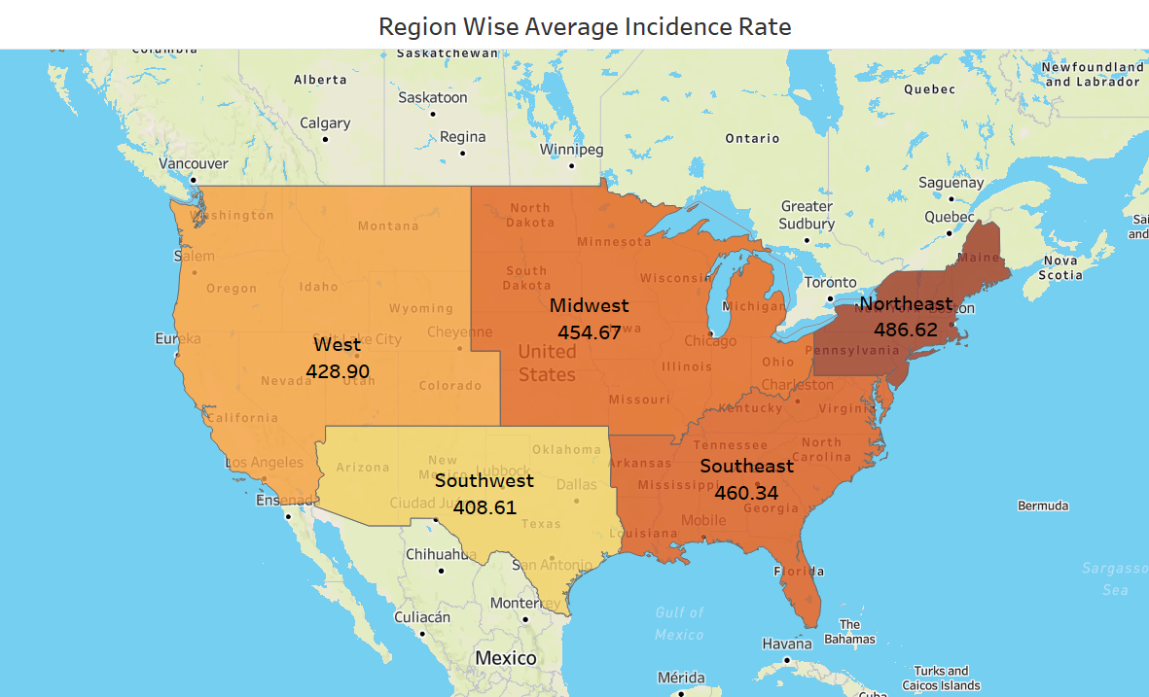
Average Incidence Rate – Region Wise
In order to provide more targeted insights for Rochester Regional Health, we further refined our analysis into five regions (West, Midwest, Southwest, Southeast, and Northeast). Utilizing the Tableau business intelligence platform, we generated a US map that displayed the average cancer incidence rate for each region. This visualization enabled us to determine that the Northeast region has the highest cancer incidence rate (486.62), while the Southwest region exhibits the lowest rate (408.61).

Slide 4
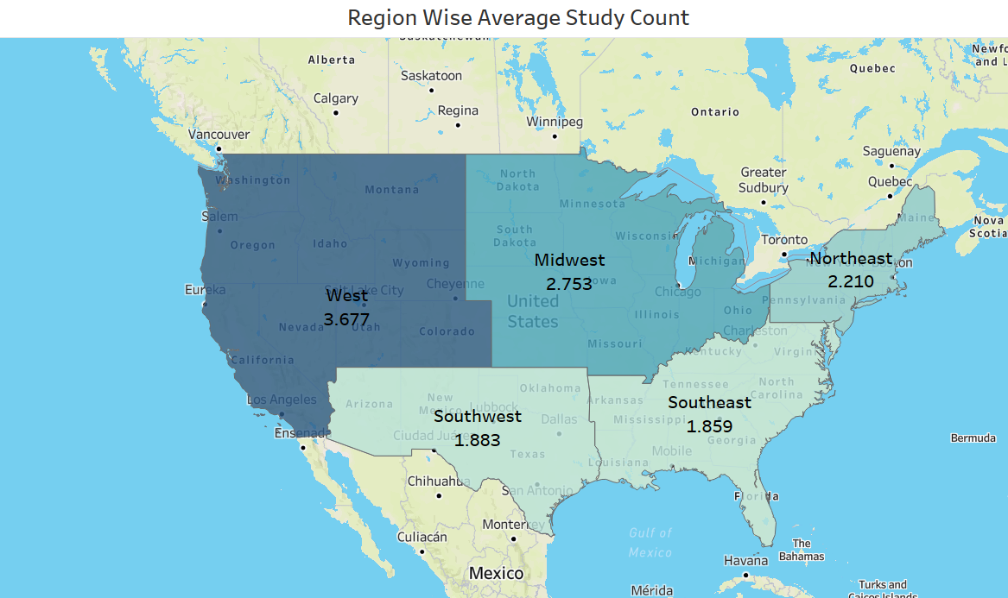
Question - 2
Average Study Count across Regions
Study Count: Highest- West Region, Lowest- South-East

Slide 5
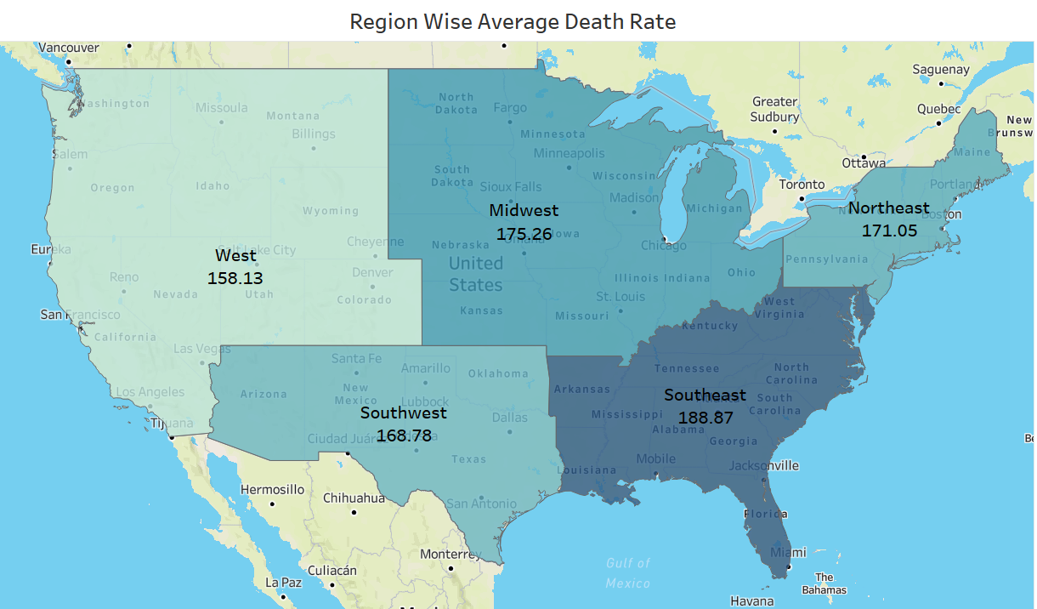
Average Death Rate across Regions
Death Rate: Highest- South-East, Lowest- West

Slide 6
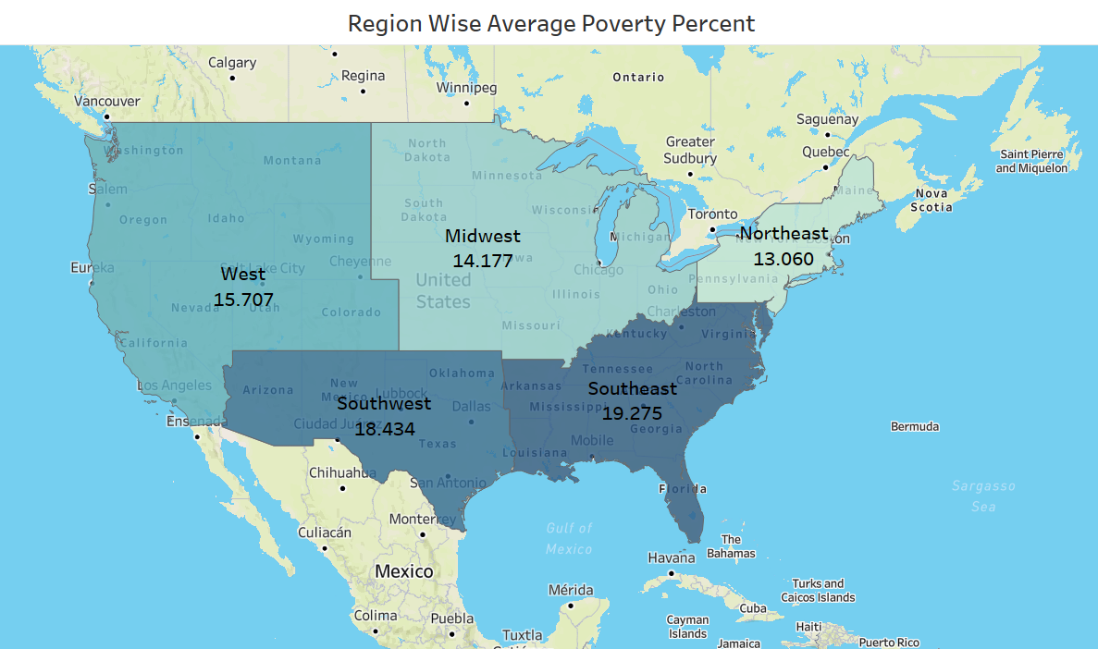
Average Poverty Percent across Regions
Poverty Percent: Highest- South-East, Lowest- North-East

Slide 7
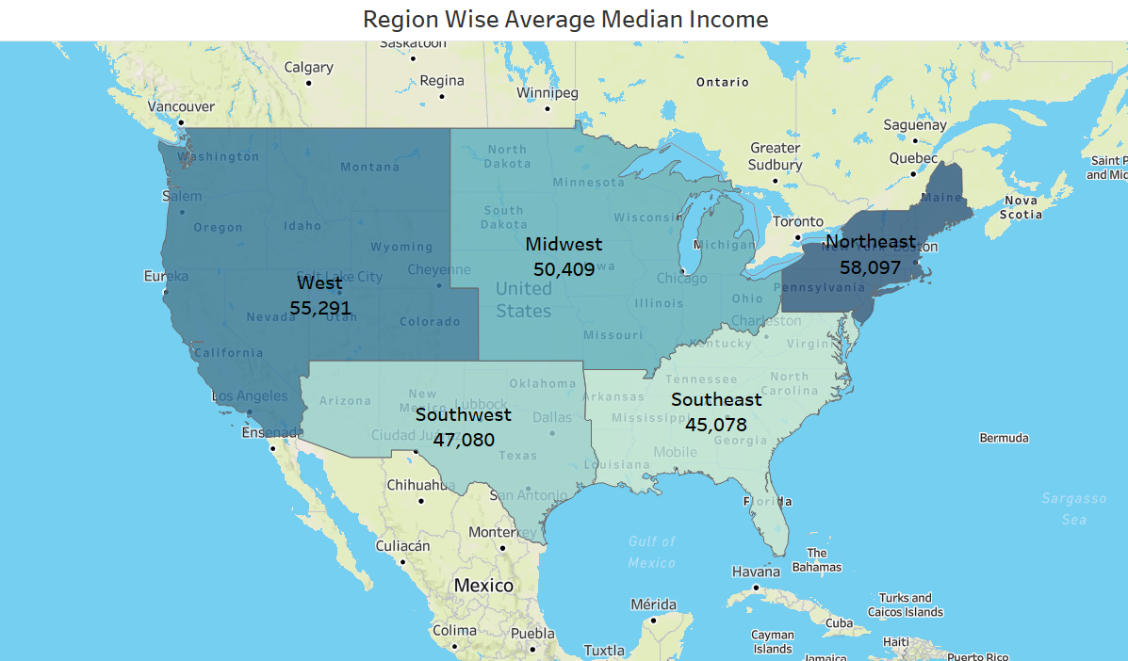
Average Median Income across Regions
Median Income: Highest- North-East, Lowest- South-East

Slide 8
Question – 2 - Summary
To examine how various factors differ across US regions, we created visualizations that highlight regional disparities in key indicators such as Study Counts, Death Rate, Poverty Percent, and Median Income. Our analysis allowed us to identify regions with the highest and lowest average values for each factor:
Study Count: Highest - West Region (3.677), Lowest - Southeast (1.859)
Death Rate: Highest - Southeast (188.87), Lowest - West (158.13)
Poverty Percent: Highest - Southeast (19.275), Lowest - Northeast (13.060)
Median Income: Highest – Northeast (58,097), Lowest – Southeast (45,078)
Key Takeaways:
The West region, with the highest average Study Count, also has the lowest Death Rate. In contrast, the Southeast region has the lowest average Study Count and the highest Death Rate.
The Southeast region, which has the highest Poverty Percent, also ranks highest in terms of Death Rate.
Intriguingly, despite having the highest Median Income among all regions, the Northeast region also has the highest average cancer Incidence Rate (as identified in Question 1).
This refined summary offers valuable insights that can help inform decision-making and better understand regional differences in cancer incidence and contributing factors.

Slide 9
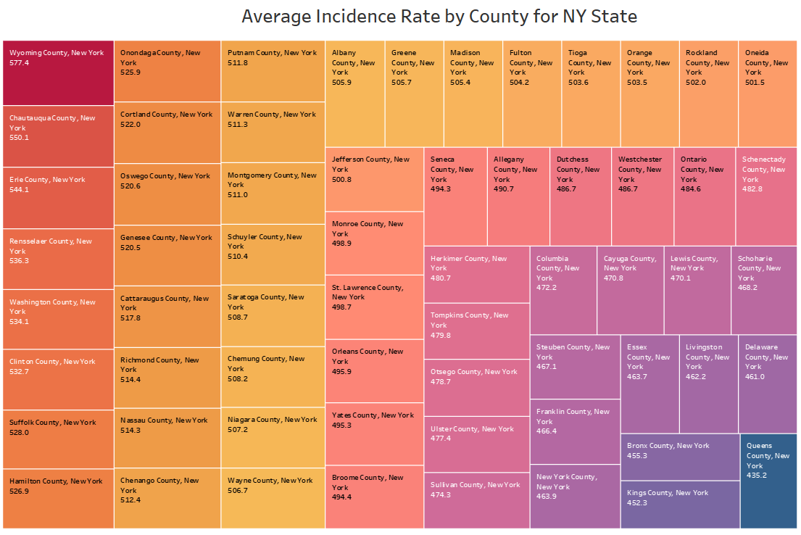
Question-3(a)
Incidence rates by County
Focusing on New York State, we aimed to identify the counties with the highest average cancer Incidence Rates. To achieve this, we created a heatmap that clearly illustrates the varying cancer incidence across counties. Our analysis revealed that Wyoming County (577.4) has the highest incidence rate, followed by Chautauqua County (550.1) and Erie County (544.1). Conversely, Queens County (435.2) has the lowest incidence rate.
This information is invaluable to RRH, enabling them to prioritize counties when planning and implementing cancer prevention and treatment initiatives. Additionally, the heatmap can serve as a useful tool for conducting further studies to compare and understand the differences between counties with the highest and lowest incidence rates.

Slide 10
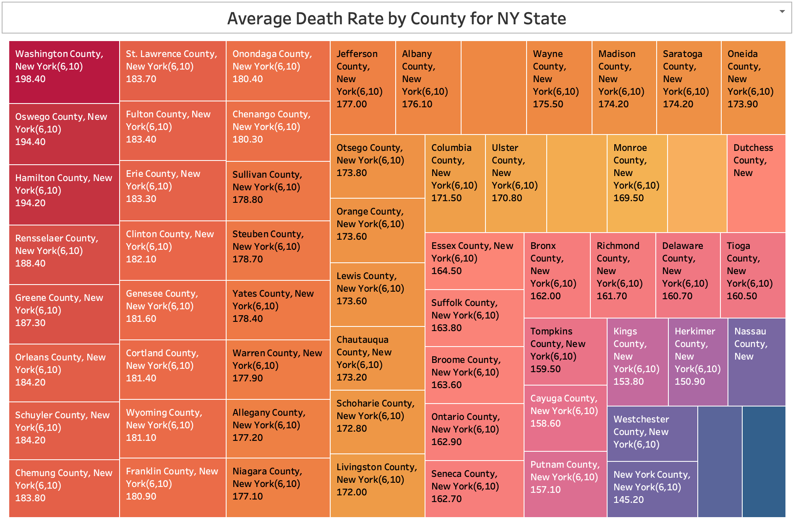

Question-3(A)
DEATH rates by County
Focusing on New York State, we sought to identify the counties with the highest average cancer Death Rates. To accomplish this, we created a heatmap that clearly depicts the distribution of cancer mortality across the counties. Our analysis revealed that Washington County (198.4) has the highest death rate, followed by Oswego County (194.40) and Hamilton County (194.20). On the other hand, Queens County (138.80) has the lowest death rate.
This information is crucial for RRH in prioritizing counties when organizing various cancer prevention and treatment activities. Furthermore, the heatmap can be a valuable resource for conducting additional studies comparing counties with the highest and lowest death rates.
Queens 138.80

Slide 11
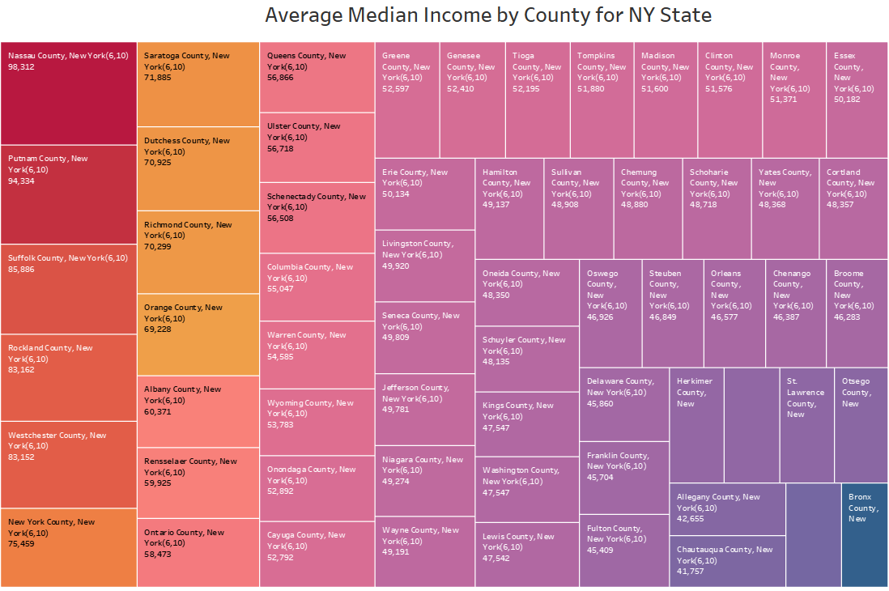

Question-3(A)
Median income by County
In our analysis of New York State, we also examined the average median income by county. To effectively display this information, we created a heatmap that visually represents the income distribution across the counties. Our findings revealed that Nassau County ($98,312) has the highest median income, followed by Putnam County ($94,334) and Suffolk County ($85,886). Conversely, Bronx County ($33,687) has the lowest median income.
This information is vital for RRH to understand the economic landscape of the counties when planning and implementing various cancer prevention and treatment initiatives. Moreover, the heatmap can be an essential tool for conducting further studies comparing counties with the highest and lowest median incomes, potentially uncovering correlations between income and cancer-related factors.
Bronx 33,687

Slide 12
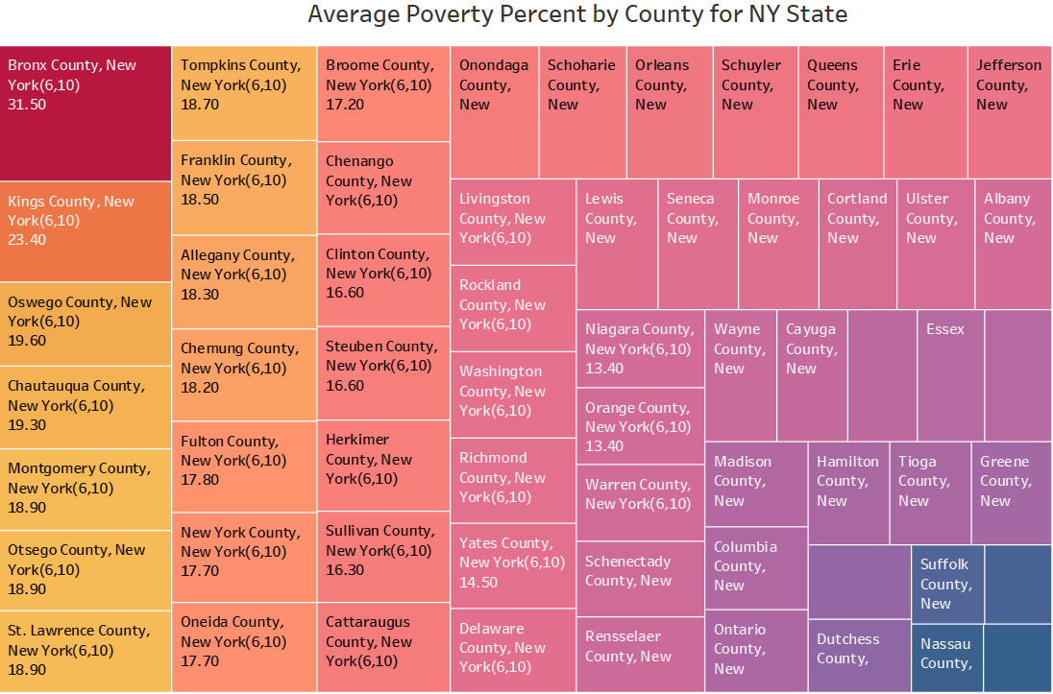

Question-3(a)
Poverty percent by County
In our continued analysis of New York State, we focused on the poverty percentage by county, creating a heatmap to effectively visualize this data. Our findings showed that Bronx County has the highest poverty rate (31.50%), followed by Kings County (23.40%) and Oswego County (19.60%). On the other hand, Putnam County has the lowest poverty percentage (6.30%).
This information is crucial for RRH in understanding the socioeconomic context of each county when planning and executing various cancer prevention and treatment programs. The heatmap also serves as a valuable tool for conducting further research comparing counties with the highest and lowest poverty percentages, potentially revealing correlations between poverty and cancer-related factors.
Putnam 6.30%

Slide 13
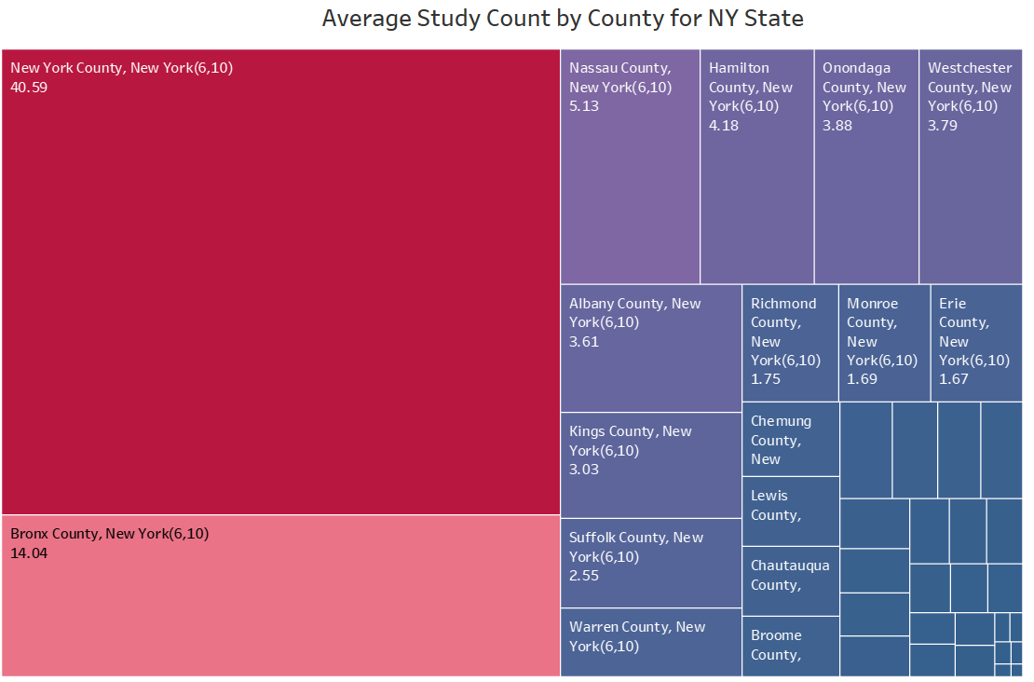
Question-3(a)
Study count by County
In our latest analysis, we developed a heatmap to visualize the average study count per county within New York state. This exploration revealed noteworthy insights. New York County stands out with the highest study count at 40.59, followed by Bronx County at 14.04 and Nassau County at 5.13. On the other end of the spectrum, St. Lawrence County has the lowest study count, with a rate of merely 0.02.
These findings can help inform strategic decision-making and resource allocation when addressing cancer-related issues in different counties across the state.
St. Lawrence

Slide 14
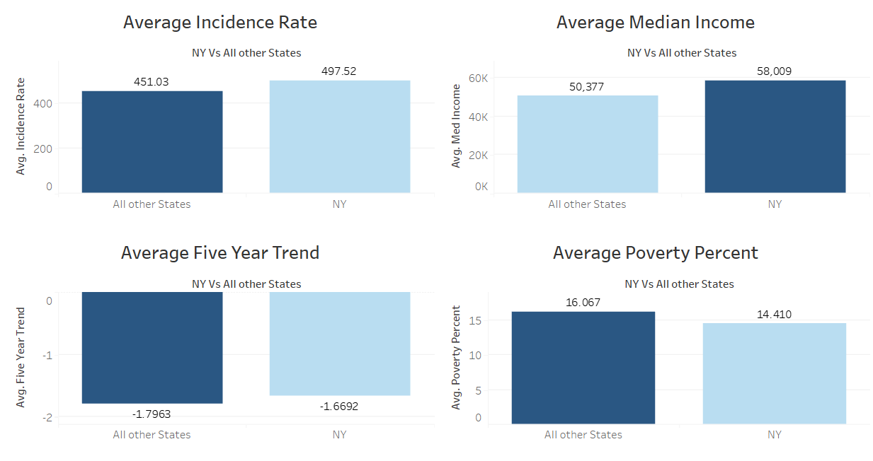



Question-3(b)
New York VS All Other U.S. States Factor Comparison

Slide 15
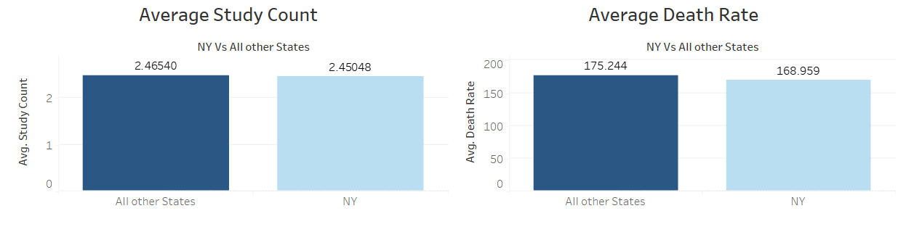
Question-3(b)
New York VS All Other U.S. States Factor Comparison

Slide 16
Question – 3(b) - takeaways
To equip RRH with meaningful insights and benchmarks, we carried out a comparative analysis of the incidence rate and key factors influencing cancer proliferation in New York State as compared to the rest of the United States. Our findings revealed that the cancer incidence rate in New York is 10% higher than the national average, while the death rate is 3.7% lower. Notably, the economic situation in New York is more favorable than in the rest of the country, with the average median income being 15.1% higher and the average poverty percentage being 1.7% lower than the national figures.
These statistics provide a foundation for further investigation into the factors that impact cancer incidence rates, a subject we will delve deeper into throughout our study.

Slide 17
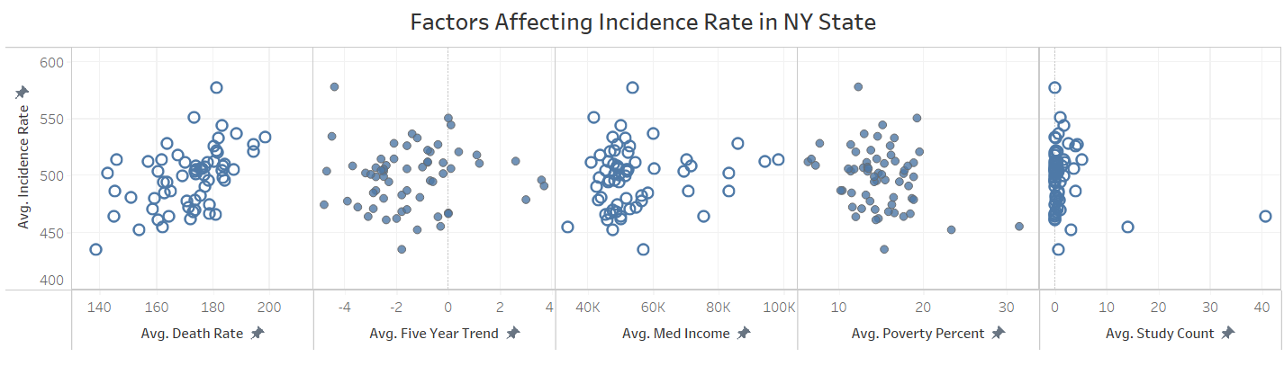
Question-3(c )
Factors influencing Incidence Rate in NY state

Slide 18
Question – 3(c ) - takeaways
Upon conducting a regression analysis of various factors, we chose to concentrate on the variables that demonstrate a significant correlation with the cancer incidence rate.
Firstly, we examined the "Poverty Percentage" factor, which exhibits a strong negative correlation with the dependent variable, Incidence Rate. This implies that for every decrease in Poverty Percent, the incidence rate will increase by 1.8%.
Secondly, the Death Rate has a positive relationship with the incidence rate, indicating that cancer is one of the primary causes of death in New York.
By honing on these crucial factors, we can better understand the dynamics that influence cancer incidence rates in the region.

Slide 19
Question – 3(d)
Recommendations for RRH and Health professionals
Rochester Regional Health (RRH) is a leading hospital in Rochester, offering a wide range of services to patients. In our research, we analyzed and visualized data from the American Cancer Society to identify factors influencing cancer incidence rates and formulated recommendations accordingly.
Geographical Focus: Our analysis of New York State revealed the counties with the highest cancer incidence rates: Wyoming, Chautauqua, and Erie. These areas exhibit significantly higher incidence rates than others, suggesting that geographical factors should be considered by healthcare professionals. From a business perspective, RRH could prioritize these counties and promote its services more actively in these areas to attract additional patients.
Death Rate Correlation: We found a strong correlation between cancer incidence rates and death rates in New York State, indicating that cancer may be a major contributor to overall mortality. Healthcare professionals should place greater emphasis on studying late-stage cancer diseases. Concurrently, from a business standpoint, RRH may consider expanding its hospice services and support for patients with advanced cancer to better address their needs.
Socio-Economic Impact: Our data revealed a significant correlation between poverty percentage and cancer incidence rates, suggesting that individuals facing financial challenges may be more susceptible to cancer. RRH should focus on promoting cancer prevention strategies among lower socio-economic groups. From a business perspective, RRH could consider implementing special discount programs for financially disadvantaged individuals, allowing them to access necessary treatments. This approach has the potential to increase RRH's revenue by attracting a larger patient base.
By implementing these recommendations, RRH can effectively address the needs of the community while also expanding its services and patient base.

Slide 20
Question - 4
Project Summary
In this project, we employed the "Tableau" business intelligence tool to distill extensive data sets into visually appealing and informative graphics. One of the main challenges we faced was formulating accurate hypotheses about the significant factors while mastering the nuances of the software to select the most effective visuals for conveying our insights.
Throughout our work, we used various visualization approaches tailored to the specific insights we aimed to present. To assess regions most affected by cancer, we implemented a mapping visualization using the Incidence Rate measure. This method allowed us to generate a color-gradient map of US states, emphasizing states with higher incidence rates (dark blue) and those with lower rates (light blue).
Additionally, we employed scatterplot charts to uncover correlations between the Incidence Rate and other variables. Consequently, we found that Death Rate, Poverty Percent, and Median Income bear a strong relationship with the cancer incidence rate. This vital information can assist healthcare professionals and RRH in identifying new business opportunities and priority areas.
In conclusion, we successfully met the project's goals by delivering valuable recommendations and insights to our client for future research and potential business expansion.

